Slide 1
PULSE OXIMETER AND HEART RATE MONITORING SYSTEM

Slide 2
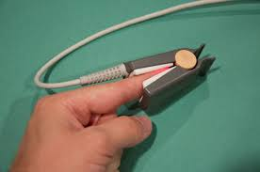
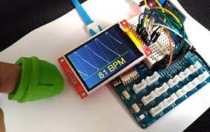
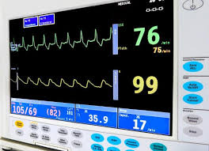
Introduction
Many further problems can be avoided if we could know heart rates and our oxygen level at right time.
In this project, we seek to monitor a patient's heart rate using pulse sensor and blood-oxygen level using a pulse
oximeter. The system used here is the heart rate monitoring model, this can be used in almost all the hospitals as
well as for general purposes like residential area. In this system, we have used pulse sensor to find the nearby or the actual value of heart beat rate of a normal person. Whenever problem arises in one’s heart functioning, in order to check the heart rate value this method is considered as the best method. When there is a low heart rate functioning happens, we call it as bradycardia. The lower of heart beat can be either a risky thing or sometimes it happens to normal person. Them main objective of our project is to provide a
Simple and easy heart rate monitoring system and pulse oximeter so that it could be useful to everyone.

Slide 3

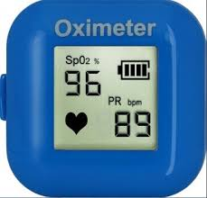

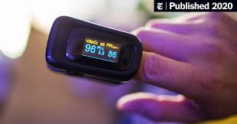
Objectives
The purpose is to examine how heart rate and the oxygen saturation of subject is measured from finger and then processed and displayed. The design, is small in size, easy to use, allows a non-invasive, real time method to provide information regarding health. This enables an efficient and economical means for managing the health care. Pulse oximetry is a useful tool in the evaluation of a patient's oxygenation status and may be used routinely in many areas of clinical practice. he Heart Rate Monitoring system’s objective is of detecting the heart beat of the patient in order to monitor the risk of heart attack and also the regular checkup. The data received from heart rate module can be saved and viewed for further medical usage.

Slide 4

Literature Review
This project is about Heart rate monitoring using pulse sensor in which the data is stored in the server for the later on use. Pulse Sensor is a simple sensor which is used in many places. The pin is constructed in such a way to indicate the heart rate. The basic sensor has three pins namely, ground and the input signal (which is also known as A0 signal). We have used pulse sensor to find the nearby or the actual value of heart beat rate of a normal person. The pulse sensor is connected to the server using Wi-Fi module (Node MCU) to track patients health. The data are sent to server using http protocol. It is like a small device which can be fixed to any atmosphere. It is a less bulky and a portable Wi-Fi module and the person can be connected to their android mobile using Wi-Fi hot spot settings.Esp8266 module can be interfaced with Arduino as well as in microcontrollers. ESP8266 Wi-Fi module plays a major role in the system. The Wi-Fi is connected to the external devices like phone, laptops etc. Once it is connected the IP address is noted in the code of Arduino software for the reference value of heart rate data. This is a compact device and can be taken anywhere easily. The heart rate device can be connected with other devices like microcontroller, MATLAB software and other suitable hardware and software can be used. It is easy to use and any people can handle it. By using the finger, we can able to find the heart rate easily. ARDUINO software for programming purpose and output will be shown in hardware part. This hardware is easy to handle and quite simple in its connections.in future this system can also be connected directly to hospital servers to manipulate patient’s data and would reduce the hectic work of monitoring various data.
This project is about Heart rate monitoring using pulse sensor in which the data is stored in the server for the later on use.
Pulse Sensor is a simple sensor which is used in many places. The pin is constructed in such a way to indicate the heart rate
. The basic sensor has three pins namely, ground and the input signal (which is also known as A0 signal).
We have used pulse sensor to find the nearby or the actual value of heart beat rate of a normal person.
The pulse sensor is connected to the server using Wi-Fi module (Node MCU) to track patients health.
The data are sent to server using http protocol. It is like a small device which can be fixed to any atmosphere.
It is a less bulky and a portable Wi-Fi module and the person can be connected to their android mobile using Wi-Fi hot spot settings.
Esp8266 module can be interfaced with Arduino as well as in microcontrollers. ESP8266 Wi-Fi module plays a major role in the system.
The Wi-Fi is connected to the external devices like phone, laptops etc. Once it is connected the IP address is noted in the code of
Arduino software for the reference value of heart rate data. This is a compact device and can be taken anywhere easily.
The heart rate device can be connected with other devices like microcontroller, MATLAB software and other suitable
hardware and software can be used. It is easy to use and any people can handle it. By using the finger, we can able to
find the heart rate easily. ARDUINO software for programming purpose and output will be shown in hardware part.
This hardware is easy to handle and quite simple in its connections.in future this system can also be connected directly to hospital servers
to manipulate patient’s data and would reduce the hectic work of monitoring various data.

Slide 5
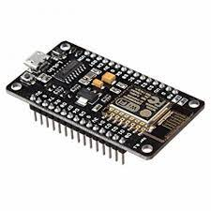
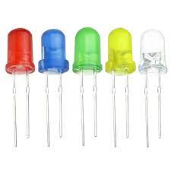
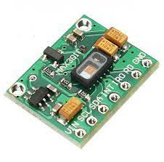
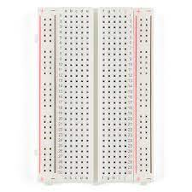
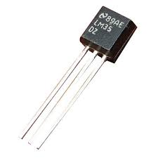
Tools and components used
NODE MCU
LED’s
MAX30102
BREADBOARD
LM35 sensor

Slide 6
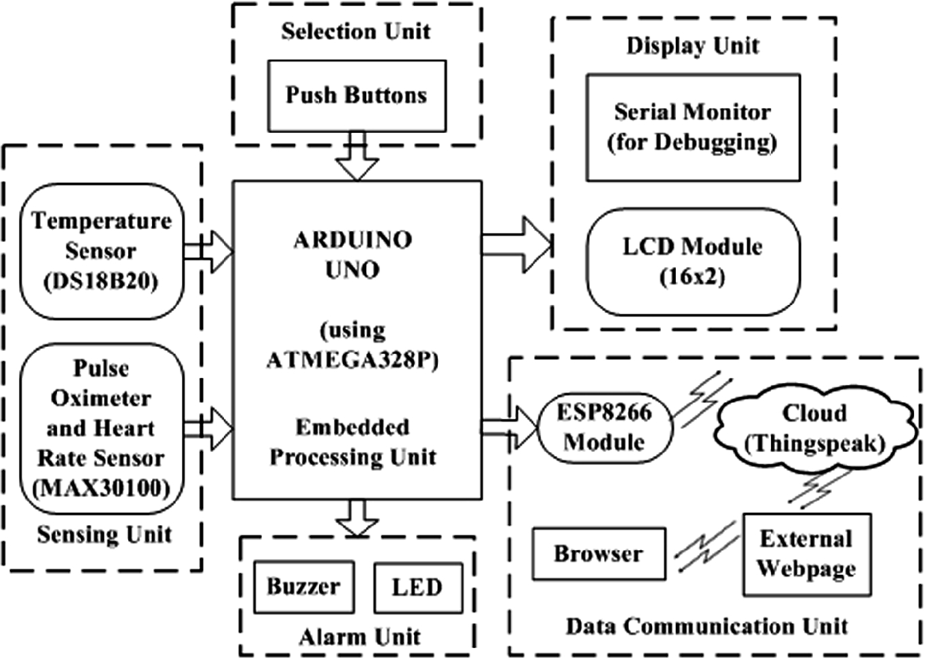
Methodology Implemented
Arduino code is programmed by using the Arduino UNO software. The program lines from 30 to 40 based on the type of functioning used. Like c program, Arduino has the header files or preprocessor files is used in it. Arduino UNO is used in both software side as well as hardware side. The pin out ranges from 1 to nearly 25 which differs from one board to another. It consists of pins namely, analog inputs, outputs, USB connection and other interfaces. The inputs can be send sequentially one by one. Thus, it uses both serial and parallel communication interfaces. The outputs can be viewed through output window and it can be located in either side of the program window. It can be either analog and digital inputs. It also uses I2 c, SPI and USB interfaces etc. The outputs can be indicated with LEDs, sensors or connected with breadboards.

Slide 7



References
1]https://www.ieee.org/
2] International Journal of Engineering and Advanced Technology (IJEAT) ISSN: 2249 – 8958, Volume-8 Issue-6, August 2019 by R.Vinodhini, R.Puviarasi on Heart Rate Monitoring System using Pulse Sensor with Data Stored on Server
3] International Journal of Engineering and Advanced Technology (IJEAT) ISSN: 2249 – 8958, Volume-9 Issue-2, December, 2019 by R.K.Parate, S.J.Sharma on
Design of a Portable Health Monitoring System Based on Node MCU
4] International Journal of Innovative Research in Electrical, Electronics, Instrumentation and Control Engineering Vol. 8, Issue 05, May 2020 by Alan Roddick.S1 , Manoj Kumar.G2 , Karthik.M3 , Ragul.R4 and P. Aravind5 on MAX30100 Based Heart Rate and SPO2 Monitoring using IoT
5] https://www.arduino.cc/

Slide 8

Group Members
Roll No. 46 Ganesh Karode
Roll No. 47 Omkar Karpe
Roll No. 48 Kartik Rupauliha (Assistant GL)
Roll No. 49 Kartik Rajput (Group Leader)
Roll No. 50 Nakul Kasar
THANKYOU…!

